Slide 1
String Algorithms and Data Structures
- Akshay Dhillon

Slide 2
String – Transform a String to Lower Case
Note: Don’t use any built-in function
Problem Statement:
Transform a String to lower case
Input:
“My Name is AKSHAY.”
Output:
“my name is Akshay.”
Input:
WWW.GOOGLE.COM
Output:
“www.google.com”
Intuition:
[A, B,…..,Y, Z]
For other characters it remains same
Loop through all the letter of String, if it’s an Uppercase character transform it to a lowercase
[a,b,…….,y,z]

Slide 3
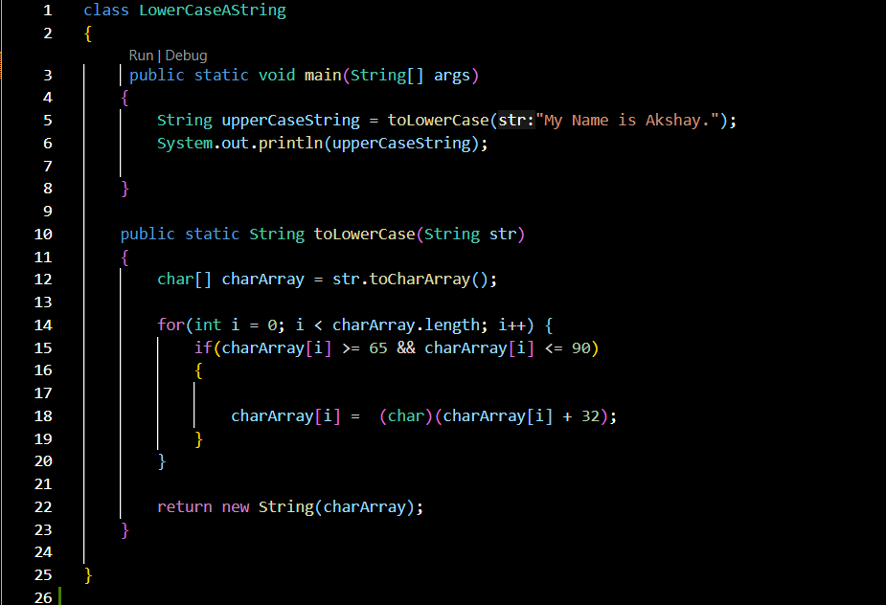
String – Transform a String to Lower Case
Note: Don’t use any built-in function

